Slide 1
Patient Management System
The Patient Management System is a database system consisting of four tables: "Patient," "Doctor," "Treats," and "Tests," all established with appropriate attributes and relationships. Patient Table stores information about patients, including their name, date of birth, phone number, and email address. Doctor Table contains details of doctors, such as their name, specialty, and phone number. Each doctor is uniquely identified by their ID. The "Treats" table establishes a relationship between patients and doctors. It includes attributes for diagnosis and treatments. This table links patients and doctors by their respective IDs. Tests Table manages information related to medical tests, including the test type and category. Each test is uniquely identified by an ID.Log table store data about the date of tests for each patient and connect patients and tests through their respective IDs.

Slide 2
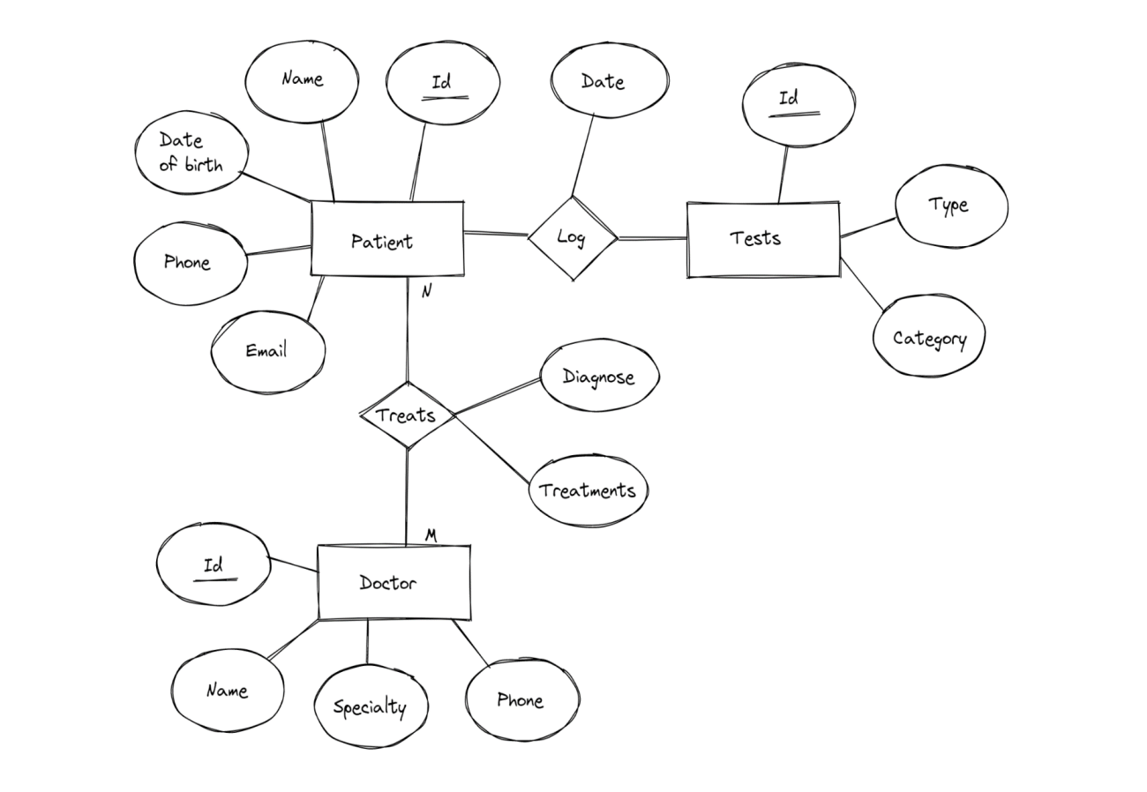
ER diagram of Patient Management System

Slide 3
PATIENT TABLE
ID | NAME | DATE_of_BIRTH | Phone | Email
1 | Rahim | 1980-09-25 | 01723874356 | 123rahim@gmail.com
2 | Karim | 1970-11-30 | 01443874356 | 567karim@gmail.com
3 | Maisha | 1986-05-12 | 01343872136 | maisha888@gmail.com
4 | Badhon | 1990-04-14 | 01923874659 | badhon004@gmail.com
5 | Rimon | 1994-02-25 | 01524774343 | rrr@gmail.com

Slide 4
DOCTOR TABLE
ID | NAME | SPECIALTY | PHONE
1 | Dr. Mahbub | CARDIOLOGY | 01370596806
2 | Dr. Quazi | Orthopedic | 01711133966
3 | Dr. AKM Musa | Endocrinologists | 01439059123
4 | Dr. Sheikh | Gastroenterologist | 01380588081
5 | Dr. Ferdous | Neuromedicine | 01169796383

Slide 5
TESTS TABLE
ID | TYPE | CATEGORY
1 | Blood Test | Medical
2 | X-Ray | Radiology
3 | MRI | Radiology
4 | Ultrasound | Radiology
5 | CT Scan | Radiology

Slide 6
TREATMENT TABLE
PATIENT ID | DOCTOR ID | DIAGNOSE | TREATMENT
1 | 1 | Hypertension | 2
2 | 2 | Fracture | 3
3 | 1 | Migraine | 1
4 | 3 | Diabetes | 2
5 | 4 | Gastric | 1

